Slide 1
Predicting Airbnb prices in Washington D.C.
Daniel Park
danielp2@umbc.edu
DATA 606

Slide 2
Recap
Finding features or elements that have the biggest impact on pricing for property listed in Airbnb
Using Machine Learning to predict Airbnb prices in Washington D.C.

Slide 3
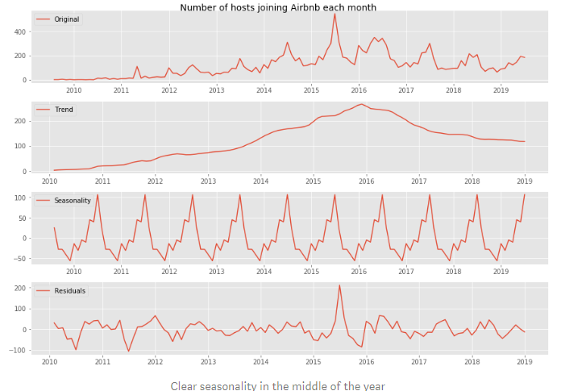
Similar Projects

Slide 4
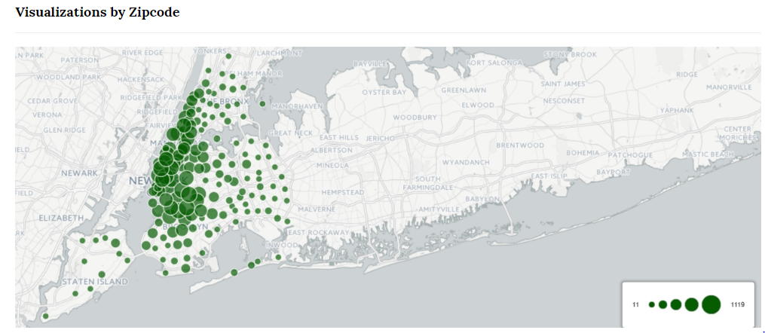
Similar Projects

Slide 5
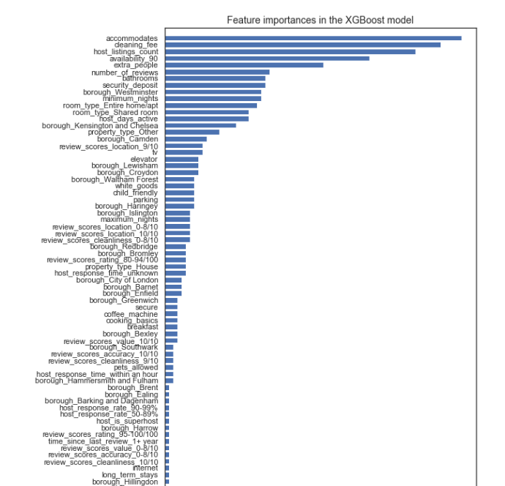
Similar Projects

Slide 6
Issues with Data
84 columns
Most of the columns are useless
A lot more data than needed to accomplish task

Slide 7
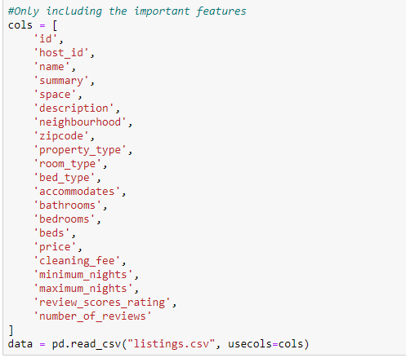
Data Cleaning

Slide 8
Future Plan
Extracting Feature Importance
Applying models to the features to accurately predict pricing in the near future.
Hedonic Model Regression and XGBoost

Slide 9
References
https://towardsdatascience.com/predicting-airbnb-prices-with-machine-learning-and-location-data-5c1e033d0a5a
https://towardsdatascience.com/predicting-airbnb-prices-with-machine-learning-and-deep-learning-f46d44afb8a6
https://www.dataquest.io/blog/machine-learning-tutorial/
https://airbnb-pricing-prediction.herokuapp.com/index.html

